Slide 1
2023-03-13

Slide 2
Unit 9 Review

Slide 3
9.1: Inheritance, Superclass, Subclass

Slide 4
OOP & Inheritance
One of the most useful features of Object-Oriented programming languages (C++, C#, Java, JavaScript, Kotlin, Python, Ruby, Scala, Swift, ActionScript) is Inheritance
Inheritance allows your program to efficiently share common code between different objects (code reuse); helps you better organize your program in ways that model the real world; and create smaller units of maintenance and testing.

Slide 5
OOP & Inheritance
One of the most useful features of Object-Oriented programming languages (C++, C#, Java, JavaScript, Kotlin, Python, Ruby, Scala, Swift, ActionScript) is Inheritance
Inheritance allows your program to efficiently share common code between different objects (code reuse); helps you better organize your program in ways that model the real world; and create smaller units of maintenance and testing.
Person
name
address
Student
name
address
locker
Teacher
name
address
office

Slide 6
OOP & Inheritance & Generalization
One of the most useful features of Object-Oriented programming languages (C++, C#, Java, JavaScript, Kotlin, Python, Ruby, Scala, Swift, ActionScript) is Inheritance
Inheritance allows your program to efficiently share common code between different objects (code reuse); helps you better organize your program in ways that model the real world; and create smaller units of maintenance and testing.
Identifying and centralizing common information is called "generalization"
Person
name
address
Student
name
address
locker
Teacher
name
address
office

Slide 7
OOP & Inheritance & Generalization
One of the most useful features of Object-Oriented programming languages (C++, C#, Java, JavaScript, Kotlin, Python, Ruby, Scala, Swift, ActionScript) is Inheritance
Inheritance allows your program to efficiently share common code between different objects (code reuse); helps you better organize your program in ways that model the real world; and create smaller units of maintenance and testing.
Person
name
address
Student
{Person}
locker
Teacher
{Person}
office

Slide 8
OOP & Inheritance & Generalization & Specialization
One of the most useful features of Object-Oriented programming languages (C++, C#, Java, JavaScript, Kotlin, Python, Ruby, Scala, Swift, ActionScript) is Inheritance
Inheritance allows your program to efficiently share common code between different objects (code reuse); helps you better organize your program in ways that model the real world; and create smaller units of maintenance and testing.
Placing class-specific information in that class is called "specialization"
Person
name
address
Student
{Person}
locker
Teacher
{Person}
office

Slide 9
Superclasses & Subclasses & UML
superclass
When using Inheritance - Subclasses (or child-classes) inherit from Superclasses (or parent-classes)
We use UML (Unified Modeling Language) to describe these relationships with child classes pointing to parent classes (with open triangle endpoints)
Person
name
address
Open arrows point from child to parent
Teacher
office
Student
locker
subclasses

Slide 10
Java & Inheritance
In Java - any class (not marked final) can be a superclass - but if a class wants to be a subclass they must use the extends keyword
class Person { public String name; public String address; }
class Teacher extends Person { public String office; }
class Student extends Person { public String locker; }
Person
name
address
Java extends only allows a single class name - this is called single-inheritance.
Teacher
office
Student
locker

Slide 11
Java & Inheritance
Subclasses inherit all the variables and methods of their superclass
class Person { public String name; public String address; public void printInfo() { System.out.println(name + " " + address); } } class Teacher extends Person { public String office; } class Student extends Person { public String locker; } | Person p = new Person(); p.name = "Gary"; p.address = "San Francisco"; p.printInfo(); Teacher t = new Teacher(); t.name = "Chris"; t.address = "San Mateo"; t.printInfo(); t.office = "215W"; Student s = new Student(); s.name = "Beatrice"; s.address = "Colma"; s.printInfo(); s.locker = "B32";

Slide 12
Java & Inheritance
Classes that do not use the extends keyword automatically extend the Object class (has been happening for every class created since Unit 5)
class Object { public String toString(); public boolean equals(Object obj); ... } class Account { public String name; public double balance; } | Object o = new Object(); o.toString(); o.equals(void); Account a = new Account(); a.toString(); a.equals(void); a.name = "Amazon"; a.balance = 0.0;

Slide 13
Java & Inheritance & is-a relationships
Using Inheritance results in classes that have is-a relationships
class Account {} | Account is-a Object
class Person {} class Teacher extends Person {} class Student extends Person {} | Person is-a Object Teacher is-a Person / Teacher is-a Object Student is-a Person / Student is-a Object
class Animal {} class Dog extends Animal {} class Snake extends Animal {} | Animal is-a Object Dog is-a Animal / Dog is-a Object Snake is-a Animal / Snake is-a Object
class Shape {} class Square extends Shape {} class Circle extends Shape {} class Triangle extends Shape {} class Pentagon extends Shape {} | Shape is-a Object Square is-a Shape / Square is-a Object Circle is-a Shape / Circle is-a Object Triangle is-a Shape / Triangle is-a Object Pentagon is-a Shape / Pentagon is-a Object

Slide 14
Java & Inheritance & is-a relationships
The instanceof operator in Java can be used to test for is-a relationships
class Account {} | Account a = new Account(); System.out.println(a instanceof Object); // true System.out.println(a instanceof Account); // true
class Person {} class Teacher extends Person {} | Person p = new Person(); System.out.println(p instanceof Object); // true System.out.println(p instanceof Person); // true Teacher t = new Teacher(); System.out.println(t instanceof Object); // true System.out.println(t instanceof Person); // true System.out.println(t instanceof Teacher); // true

Slide 15
Containment & has-a relationships
Another concept utilized by Object-Oriented programming languages is Containment - where a class is responsible for maintaining an instance of another class inside itself. This results in a has-a relationship. We have been using this quite a lot in our examples and projects
class Test { public String name; public double score; } class Course { public String name; public Test tests[10]; } class Student { public String name; public Course courses[5]; } | Test has-a String (name) Course has-a String (name) Course has-a Test[] (tests) Student has-a String (name) Student has-a Course[] (courses)

Slide 16
Modeling is-a & has-a Relationships
 |  |  | is-a OR has-a
Pet | Cat | Dog | Dog is-a Pet Cat is-a Pet
Student | Teacher | Class | Class has-a Teacher Class has-a Student
Book | Movie | Media | Movie is-a Media Book is-a Media
Circle | Shape | Square | Circle is-a Shape Square is-a Shape
Lunch | Meal | Food | Lunch is-a Meal Meal has-a Food

Slide 17
9.2: Inheritance and Constructors

Slide 18
Java & Inheritance
Note: Not a best practice to make these public
Subclasses can only access the public variables and public methods of their superclass
class Person { public String name; public String address; public void printInfo() { String info = buildInfoString(); System.out.println(info); } private String buildInfoString() { return name + " " + address; } } class Teacher extends Person { public String office; public String getBuildInfoString() { return buildInfoString(); ** ERROR ** } } | Person p = new Person(); p.name = "Gary"; p.address = "San Francisco"; p.printInfo(); Teacher t = new Teacher(); t.name = "Chris"; t.address = "San Mateo"; t.printInfo(); t.buildInfoString(); ** ERROR ** t.office = "215W";

Slide 19
Java & Inheritance
Note: This is the better practice - Keep your variables private unless you want other code to mess with 'em!
But what happens if items in the superclass are not public?
class Person { private String name; private String address; public Person(String name, String address) { this.name = name; this.address = address; } public void printInfo() { System.out.println(name + " " + address); } } class Teacher extends Person { public String office; } | Person p = new Person("Gary", "San Francisco"); p.printInfo();

Slide 20
Java & Inheritance
But what happens if items in the superclass are not public?
class Person { private String name; private String address; public Person(String name, String address) { this.name = name; this.address = address; } public void printInfo() { System.out.println(name + " " + address); } } class Teacher extends Person { public String office; } | Person p = new Person("Gary", "San Francisco"); p.printInfo();
error: constructor Person in class Person cannot be applied to given types;
class Teacher extends Person {
^
required: String,String
found: no arguments
reason: actual and formal argument lists differ in length

Slide 21
Java & Inheritance
But what happens if items in the superclass are not public?
class Person { private String name; private String address; public Person(String name, String address) { this.name = name; this.address = address; } public void printInfo() { System.out.println(name + " " + address); } } class Teacher extends Person { public String office; } | Person p = new Person("Gary", "San Francisco"); p.printInfo();
Reminder: If you declare any Constructor, Java will no longer automatically create a no-param constructor for you.
In this example, since Person has a Constructor that requires two parameters, there is no way to create a Person with zero parameters.
And this error is telling you that Teacher is malformed because there is no way to properly create its Person superclass.
error: constructor Person in class Person cannot be applied to given types;
class Teacher extends Person {
^
required: String,String
found: no arguments
reason: actual and formal argument lists differ in length

Slide 22
Java & Inheritance
Solution 1: Add a no-param constructor to Person
But what happens if items in the superclass are not public?
class Person { private String name; private String address; public Person(String name, String address) { this.name = name; this.address = address; } public void printInfo() { System.out.println(name + " " + address); } } class Teacher extends Person { public String office; } | Person p = new Person("Gary", "San Francisco"); p.printInfo();

Slide 23
Java & Inheritance
Solution 1: Add a no-param constructor to Person
But what happens if items in the superclass are not public?
class Person { private String name; private String address; public Person() { // empty } public Person(String name, String address) { this.name = name; this.address = address; } public void printInfo() { System.out.println(name + " " + address); } } class Teacher extends Person { public String office; } | Person p = new Person("Gary", "San Francisco"); p.printInfo(); Teacher t = new Teacher();
Adding a no-param constructor to Person "fixes" the error - Java now has a way to create a Teacher and its Person superclass.
But did this really fix the issue?

Slide 24
Java & Inheritance
Solution 1: Add a no-param constructor to Person
But what happens if items in the superclass are not public?
class Person { private String name; private String address; public Person() { // empty } public Person(String name, String address) { this.name = name; this.address = address; } public void printInfo() { System.out.println(name + " " + address); } } class Teacher extends Person { public String office; } | Person p = new Person("Gary", "San Francisco"); p.printInfo(); Teacher t = new Teacher(); t.printInfo();
Adding a no-param constructor to Person "fixes" the error - Java now has a way to create a Teacher and its Person superclass.
But did this really fix the issue?
Q: What is the output of t.printInfo()? A: null null

Slide 25
Java & Inheritance
Solution 1: Add a no-param constructor to Person
But what happens if items in the superclass are not public?
class Person { private String name; private String address; public Person() { // empty } public Person(String name, String address) { this.name = name; this.address = address; } public void printInfo() { System.out.println(name + " " + address); } } class Teacher extends Person { public String office; } | Person p = new Person("Gary", "San Francisco"); p.printInfo(); Teacher t = new Teacher(); t.printInfo();
Adding a no-param constructor to Person "fixes" the error - Java now has a way to create a Teacher and its Person superclass.
But did this really fix the issue?
Q: What is the output of t.printInfo()? A: null null
So let's try something else...

Slide 26
Java & Inheritance
Solution 2: Call the Person constructor from a Teacher constructor using super()
But what happens if items in the superclass are not public?
class Person { private String name; private String address; public Person(String name, String address) { this.name = name; this.address = address; } public void printInfo() { System.out.println(name + " " + address); } } class Teacher extends Person { public String office; public Teacher() { super("<a name>","<an adddress>"); } } | Person p = new Person("Gary", "San Francisco"); p.printInfo(); Teacher t = new Teacher(); t.printInfo();

Slide 27
Java & Inheritance
Solution 2: Call the Person constructor from a Teacher constructor using super()
But what happens if items in the superclass are not public?
class Person { private String name; private String address; public Person(String name, String address) { this.name = name; this.address = address; } public void printInfo() { System.out.println(name + " " + address); } } class Teacher extends Person { public String office; public Teacher() { super("<a name>","<an adddress>"); } } | Person p = new Person("Gary", "San Francisco"); p.printInfo(); Teacher t = new Teacher(); t.printInfo();
Subclasses can invoke a constructor in their superclass with super()
1) super() may only be used on the first line of a subclass constructor
2) the params you pass to super() determine which superclass constructor is invoked

Slide 28
Java & Inheritance
Solution 2: Call the Person constructor from a Teacher constructor using super()
But what happens if items in the superclass are not public?
class Person { private String name; private String address; public Person(String name, String address) { this.name = name; this.address = address; } public void printInfo() { System.out.println(name + " " + address); } } class Teacher extends Person { public String office; public Teacher() { super("<a name>","<an adddress>"); } } | Person p = new Person("Gary", "San Francisco"); p.printInfo(); Teacher t = new Teacher(); t.printInfo();
Subclasses can invoke a constructor in their superclass with super()
1) super() may only be used on the first line of a subclass constructor
2) the params you pass to super() determine which superclass constructor is invoked
Q: Now what is the output of t.printInfo()? A: <a name> <an address>

Slide 29
Java & Inheritance
Solution 2: Call the Person constructor from a Teacher constructor using super()
But what happens if items in the superclass are not public?
class Person { private String name; private String address; public Person(String name, String address) { this.name = name; this.address = address; } public void printInfo() { System.out.println(name + " " + address); } } class Teacher extends Person { public String office; public Teacher() { super("<a name>","<an adddress>"); } } | Person p = new Person("Gary", "San Francisco"); p.printInfo(); Teacher t = new Teacher(); t.printInfo();
Subclasses can invoke a constructor in their superclass with super()
1) super() may only be used on the first line of a subclass constructor
2) the params you pass to super() determine which superclass constructor is invoked
Q: Now what is the output of t.printInfo()? A: <a name> <an address>
Better - But probably still not the best solution...

Slide 30
Java & Inheritance
Solution 3: Invoke super() from a 2-param Teacher constructor
But what happens if items in the superclass are not public?
class Person { private String name; private String address; public Person(String name, String address) { this.name = name; this.address = address; } public void printInfo() { System.out.println(name + " " + address); } } class Teacher extends Person { public String office; public Teacher(String name, String address) { super(name, address); } } | Person p = new Person("Gary", "San Francisco"); p.printInfo(); Teacher t = new Teacher("Chris", "Thilgen"); t.printInfo();

Slide 31
Java & Inheritance
Solution 3: Invoke super() from a 2-param Teacher constructor
But what happens if items in the superclass are not public?
class Person { private String name; private String address; public Person(String name, String address) { this.name = name; this.address = address; } public void printInfo() { System.out.println(name + " " + address); } } class Teacher extends Person { public String office; public Teacher(String name, String address) { super(name, address); } } | Person p = new Person("Gary", "San Francisco"); p.printInfo(); Teacher t = new Teacher("Chris", "San Mateo"); t.printInfo();
Q: Now what is the output of t.printInfo()? A: Chris San Mateo

Slide 32
Java & Inheritance
Solution 3: Invoke super() from a 2-param Teacher constructor
But what happens if items in the superclass are not public?
class Person { private String name; private String address; public Person(String name, String address) { this.name = name; this.address = address; } public void printInfo() { System.out.println(name + " " + address); } } class Teacher extends Person { public String office; public Teacher(String name, String address) { super(name, address); } } | Person p = new Person("Gary", "San Francisco"); p.printInfo(); Teacher t = new Teacher("Chris", "San Mateo"); t.printInfo();
Q: Now what is the output of t.printInfo()? A: Chris San Mateo
Huzzah!

Slide 33
Java & Inheritance - Access Modifiers
We have previously discussed the private and public keywords (Access Modifiers) and how they are used inside a class to block or allow access to internal methods and variables to code outside the class protected is another Access Modifier that can be used to allow access to internal methods and variables to subclasses of the class (so it is mostly like private except for subclasses)
class Person { public String name; protected String age; private String taxId; } class Teacher extends Person {} class Pet {}
 | Can Access | Cannot Access
Person | Person.name Person.age Person.taxId
Teacher | Person.name Person.age | Person.taxId
Pet | Person.name | Person.age Person.taxId

Slide 34
Java & Inheritance
Summary
Subclasses do not have access to the private variables and private methods of their superclass (create accessor methods or carefully decorate items with protected)
Subclasses can use the super() function to invoke superclass constructors
super()can only be used on the first line of a subclass constructor (to prevent subclasses from interfering with the creation of the superclass)
The params passed to super() determine which constructor in the superclass is invoked
If you do not add a call to super() in a subclass constructor - Java will automatically add call to super() with no params - i.e. it will call the no-param constructor of the superclass (to ensure that the super-class is properly created; because the subclass depends on it)

Slide 35
9.3 Overriding Methods

Slide 36
Overriding Methods
Method Overriding - To implement a new version of a method to replace code that would otherwise have been inherited from a superclass
To override a method from a superclass, implement the method in the subclass.
public class Turtle {
private int x, y;
public void forward(int z) {
x += z;
} public int getX() { return x; } public void setX(int x) { this.x = x; } }
public class TurboTurtle extends Turtle {
public void forward(int z) {
setX(getX() + 100*z);
}
}
// QUESTION: Why did we have to use the // accessor methods in TurboTurtle instead // of just saying x += 100*z?

Slide 37
Confuseth them not: Overloading and Overriding
We learned previously about Method Overloading: defining methods with the same name but different method signatures.
When you overload a method, you implement a new method with the same name but different parameters.
Overriding a method is very different than overloading a method.
Overriding replaces an inherited method.
Overloading creates a complementary method with the same name.
Overloading
public class MyMath {
public double sqr(double x) { ... }
public int sqr(int x) { ... }
}
Overriding
public class MyBetterMath extends MyMath {
// I have come up with a FASTER, // more efficient method to square // doubles!
@Override public double sqr(double x) { ... }
}

Slide 38
Failure To Override
class Base {
public void method() { System.out.println("Base.method"); }
}
class OverrideTest extends Base {
public void methud() { System.out.println("OverrideTest.method"); }
public static void main(String args[]) { new OverrideTest().method(); }
}
To override a method, you must match the method signature exactly. (Parameter names can be different... but the method name, return type, and parameter types must all match.) If you don't match it up, you may accidentally create an overloaded method! And the compiler will not warn you.
Accidental typo

Slide 39
@Override
Trying to override: public boolean equals(Object other); in class Object
class Rectangle {
@Override
public boolean equals(Rectangle other) { return other != null && left == other.left && top == other.top && right == other.right && bottom == other.bottom; }
}
Annotations are additional information that can be specified on Java methods, variables and classes. They start with @
@Override is an annotation which tells the compiler that you're trying to override a method... and if your declaration doesn't actually override a method, you get a helpful compile error.
(Why an annotation, not a keyword like C#? Adding keywords to an existing language is hard.)
Rectangle.java:3: error: method does not override or implement a method from a supertype
@Override
^
1 error

Slide 40
The Object Superclass
All classes are subclasses of the Object class.
(Not necessarily direct subclasses... there are often some superclasses in between.)
When you code, you want to use as specific a type as you can, but this is legal: Object myObject = "Hello, world!";
because every String is also an Object.
You also can assign a String to an Object variable, or otherwise use a String in any Object context.
It is always legal and requires no special syntax to convert a reference to a superclass reference: String myString = "Hello, world!"; Object myObject = myString;

Slide 41
The Object Superclass
The Object class lives in the java.lang package, which is where classes fundamental to the Java language live, like java.lang.String.
Object has several public methods. This means that all Java objects inherit these methods. Many of them can be overridden.
Some of the most common ones to override are:
public String toString();
public boolean equals(Object o);

Slide 42
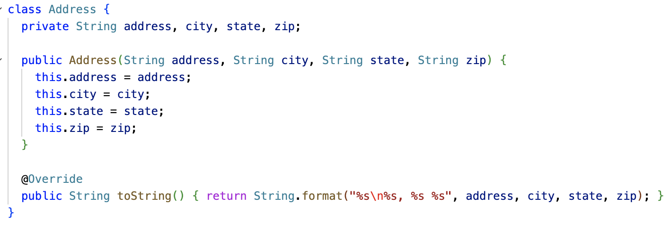
Overriding the toString method

Slide 43
Overriding the equals method
Note that the equals method compares the object with type Object.
So any object can be compared with any other object, of any class, using the equals method!
However, you often want your object to only be equal to objects of the same class, and you may need to compare member variables specific to your class.
What happens if you don't override Object.equals? The default implementation is essentially the same as == on reference types: It returns true if the other object is the exact same object instance.
@Override public boolean equals(Object o) { // returns true or false }
Careful:
public boolean equals(MyClass o) is NOT an override of Object.equals... It would make a separate overloaded method, with no warning/error unless you say @Override!

Slide 44
Casting
The type cast operator () makes it possible to convert a reference of superclass type (such as Object) to a subclass type (such as Student).
This only works if the superclass reference really IS pointing to an instance of the subclass!
If it isn't, a ClassCastException will be thrown.
NOTE: You do NOT need the (cast) operator to go from a subclass type to a superclass! Object obj = new String("Hello");
class Student { private String name; private String id; @Override public boolean equals(Object o) { if (o == null) { return false; } Student student = (Student)o; return name.equals(student.name) && id.equals(student.id); } }
Bug: This could throw
ClassCastException, if one passes, say, a Date or String to this method.

Slide 45
instanceof operator
The instanceof operator lets you check the "is-a" relationship of an object with a class.
x instanceof T evaluates to true if the object reference x is of type T.
Using instanceof, we can check that the cast to Student is safe before doing it.
An alternative is to try/catch ClassCastException, but that's more expensive.
class Student { private String name; private String id; @Override public boolean equals(Object o) { if (o == null || !(o instanceof Student)) { return false; } Student student = (Student)o; return name.equals(student.name) && id.equals(student.id); } }

Slide 46
Object.equals contract
Java defines a contract that Object.equals implementations must follow:
Reflexive: x.equals(x) is true
Symmetric: if x.equal(y) is true, y.equals(x) is true
Transient: if x.equals(y) and y.equals(z) are true, x.equals(z) is true
Consistent: x.equals(y) should return the same thing if you call it again, if nothing about them changed
Handles null: x.equals(null) should return false. (And it shouldn't crash with a NullPointerException!)
class Student { private String name; private String id; @Override public boolean equals(Object o) { if (o == null || !(o instanceof Student)) { return false; } Student student = (Student)o; return name.equals(student.name) && id.equals(student.id); } }

Slide 47
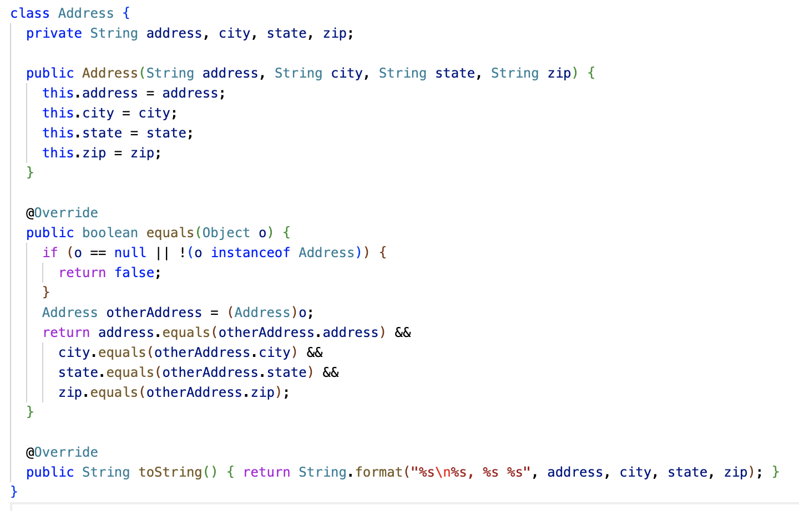
Overriding Object.equals

Slide 48
String overrides Object.equals
String z = “z”;
String a = z + z;
String b = “zz”;
String c = b;
a == b; // false because a and b refer to different strings
b == c; // true because c and b refer to the same strings
a.equals(b); // true because the values of a and b are the same
c.equals(b); // true because c and b refer to the same string

Slide 49
9.4 super.method()

Slide 50
super.method()
We saw super() already in Section 9.2. In that case, super() is used for what’s called “constructor chaining,” where a subclass constructor calls a superclass constructor.
The super keyword can also be used to invoke a superclass's version of a method, even if the subclass overrides the method.
Often, an overridden method wants to do everything the original method did, but add on some additional behavior.

Slide 51
super.method()
class Person { ... public void dump(PrintWriter pw) { pw.println("Name: " + name); } } class Teacher extends Person { private String classroom; ... public void dump(PrintWriter pw) { super.dump(pw); System.out.println("Classroom: " + classroom); } }

Slide 52
super.method() and super() differences
If you don't use super() to do constructor chaining in a subclass, Java essentially does it for you. It will add an implicit super() to call the no-param constructor of the superclass, if one exists.
This is done because Java regards constructors as really important to getting a properly initialized object. You can't skip around a superclass constructor.
Method overrides are different. Java lets you completely replace the definition of a method. The new method code has a choice: It can use super.method() to call the superclass version of the method at some point, or not.

Slide 53
super.method()
class NPC { ... public void tick() { // Implements random movement of the NPC around the map } } class Teacher extends NPC { ... public void tick() { super.tick(); // call super.tick() to get the basic NPC behavior like random movement // Additional code here for special NPC behavior specific to this character } }

Slide 54
You don't need super.method() all the time!
In a subclass, you can invoke any public or protected method of that class's superclasses.
You don't need to say super.method() to get at these methods. You can just say method().
You only need super.method() when your subclass has overridden method(), but you still need to invoke the original version of the method.
super.method() is usually called from the body of the subclass's implementation of method()!

Slide 55
9.5: Inheritance Hierarchies

Slide 56
Inheritance Hierarchy
Inheritance allows your program to efficiently share common code between different objects (code reuse); helps you better organize your program in ways that model the real world; and create smaller units of maintenance and testing.
When you use multiple layers of Inheritance in your program you end up with a set of relationships called an Inheritance Hierarchy - most often illustrated as a tree

Slide 57
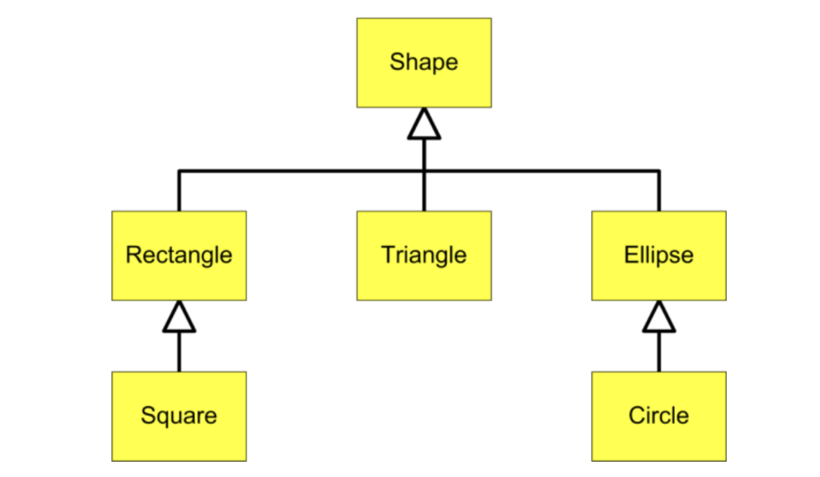
Geometric Shapes

Slide 58
Inheritance Hierarchy
This Inheritance Hierarchy shows the relationships between various geometric shapes.
Remember: In UML (Unified Modeling Language) child classes point to parent classes with open triangle endpoints
Circle is-a Ellipse
Ellipse is-a Shape
Triangle is-a Shape
A Square is-a Rectangle
Rectangle is-a Shape

Slide 59
Inheritance Hierarchy
This Inheritance Hierarchy shows the relationships between various geometric shapes.
Remember: In UML (Unified Modeling Language) child classes point to parent classes with open triangle endpoints
Circle is-a Ellipse
Ellipse is-a Shape
Triangle is-a Shape
A Square is-a Rectangle
Rectangle is-a Shape
Circle and Square are also Shapes; They satisfy the is-a relationship test with Shape

Slide 60
Inheritance Hierarchy
The is-a relationship allows you to make use of different types of variable types to hold references to different types of Objects Circle is-a Ellipse Ellipse is-a Shape
Circle c = new Circle() Ellipse e = c; Shape s = c;

Slide 61
Inheritance Hierarchy
The is-a relationship allows you to make use of different types of variable types to hold references to different types of Objects Circle is-a Ellipse Ellipse is-a Shape
Circle c = new Circle() Ellipse e = c; Shape s = c;
This means you can create an Array/ArrayList of Shapes and add any one of these Objects to it!

Slide 62
Inheritance Hierarchy
The is-a relationship allows you to make use of different types of variable types to hold references to different types of Objects Circle is-a Ellipse Ellipse is-a Shape
Circle c = new Circle() Ellipse e = c; Shape s = c;
This means you can create an Array/ArrayList of Shapes and add any one of these Objects to it!
Combine this with method overrides and you can build some pretty cool stuff - More on that in the next section!

Slide 63
Inheritance Hierarchy
But this only works in one direction - subclass types can become superclass types; but superclass types cannot become subclass types Circle is-a Ellipse Ellipse is-a Shape
Shape s = new Shape() Rectangle r = s; Triangle t = s; Ellipse e = e;

Slide 64
Inheritance Hierarchy
But this only works in one direction - subclass types can become superclass types; but superclass types cannot become subclass types Circle is-a Ellipse Ellipse is-a Shape
Shape s = new Shape() Rectangle r = s; **ERROR** Triangle t = s; **ERROR** Ellipse e = e; **ERROR**

Slide 65

Inheritance Hierarchy
But this only works in one direction - subclass types can become superclass types; but superclass types cannot become subclass types Circle is-a Ellipse Ellipse is-a Shape
Shape s = new Shape() Rectangle r = s; **ERROR** Triangle t = s; **ERROR** Ellipse e = e; **ERROR**
In this Inheritance Hierarchy there are FIVE subclasses that "could" be a Shape - It is unsafe to assume that a Shape is any one of them!

Slide 66
9.6: Polymorphism

Slide 67
Quick review: compile time vs. runtime
Executing a java program has two steps. First, the program must be compiled (e.g. turned into 1s and 0s that your computer can understand) and then run
The first step of this process is orchestrated by a program called a compiler.
This is the program that yells at you if you try to use a variable before you’ve initialized it
Compilation involves checking a bunch of syntactic “rules” to make sure that your program logic is well-defined
But you can also encounter error messages generated at runtime
For example, an error message that says you tried to divide by zero
These kinds of error can’t be identified a priori–your code needs to be run for these issues to be caught

Slide 68
Polymorphism
In Java when you create an Object with new() - an instance of that specific type is created. The instance will always be an instance of that compile-time type regardless of what its current run-time type is.
class Shape { public void draw() { System.out.println(this.getClass()); } } class Rectangle extends Shape {} class Triangle extends Shape {} class Ellipse extends Shape {} | Shape shapes[] = new Shape[3]; shapes[0] = new Rectangle(); shapes[1] = new Triangle(); shapes[2] = new Ellipse(); for (Shape s : shapes) { s.draw(); }

Slide 69
Polymorphism
In Java when you create an Object with new() - an instance of that specific type is created. The instance will always be an instance of that compile-time type regardless of what its current run-time type is.
class Shape { public void draw() { System.out.println(this.getClass()); } } class Rectangle extends Shape {} class Triangle extends Shape {} class Ellipse extends Shape {} | Shape shapes[] = new Shape[3]; shapes[0] = new Rectangle(); shapes[1] = new Triangle(); shapes[2] = new Ellipse(); for (Shape s : shapes) { s.draw(); } > class Rectangle > class Triangle > class Ellipse

Slide 70
Polymorphism
In Java when you create an Object with new() - an instance of that specific type is created. The instance will always be an instance of that compile-time type regardless of what its current run-time type is.
The Object instances living in the shapes array have compile-time types of Rectangle, Triangle, and Ellipse (because that is the type that was created with new)
class Shape { public void draw() { System.out.println(this.getClass()); } } class Rectangle extends Shape {} class Triangle extends Shape {} class Ellipse extends Shape {} | Shape shapes[] = new Shape[3]; shapes[0] = new Rectangle(); shapes[1] = new Triangle(); shapes[2] = new Ellipse(); for (Shape s : shapes) { s.draw(); } > class Rectangle > class Triangle > class Ellipse

Slide 71
Polymorphism
In Java when you create an Object with new() - an instance of that specific type is created. The instance will always be an instance of that compile-time type regardless of what its current run-time type is.
class Shape { public void draw() { System.out.println(this.getClass()); } } class Rectangle extends Shape {} class Triangle extends Shape {} class Ellipse extends Shape {} | Shape shapes[] = new Shape[3]; shapes[0] = new Rectangle(); shapes[1] = new Triangle(); shapes[2] = new Ellipse(); for (Shape s : shapes) { s.draw(); } > class Rectangle > class Triangle > class Ellipse
As we perform the for-in loop - each element of shapes is assigned to a Shape variable - this is the run-time type of each Object instance inside the loop (the compile-time class never changes)

Slide 72
Polymorphism
The compiler
Uses the compile-time type to verify that the methods you are trying to use are available to an object of that type.
The code won’t compile if the methods don’t exist in that class or some parent class of that class.
During runtime
Uses the run-time type to determine which methods are used
When a method is called the first place that is checked for that method is the class that created the object. If the method is found there it will be executed. If not, the parent of that class will be checked and so on until the method is found.

Slide 73
Polymorphism
Polymorphic Assignment
Shape s = new Rectangle();
Polymorphic Parameters
public void print(Shape s){}
Polymorphic Collections
Shape[] shapeArray = { new Rectangle(), new Square() };

Slide 74
Polymorphism
Polymorphic Assignment
Shape s = new Rectangle();
Polymorphic Parameters
public void print(Shape s){}
Polymorphic Collections
Shape[] shapeArray = { new Rectangle(), new Square() };
There are no errors at compile-time because the compiler checks that the “subclass is-a superclass” relationship is true.
At run-time, the Java runtime will use the object’s actual subclass type and call the subclass methods for any overridden methods.
This is why they are polymorphic – the same code can have different results depending on the object’s actual type at run-time.

Slide 75
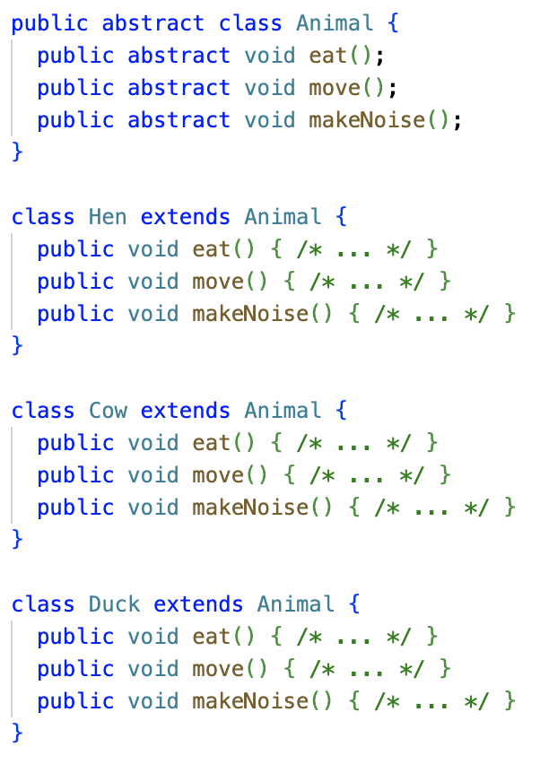
Abstract Classes
Abstract classes are declared with the abstract keyword.
Abstract classes cannot be instantiated directly! They must be subclassed.
They usually embody some concept, like Animal, that needs to be made concrete in a subclass like Fox.
Abstract classes are related to polymorphism, in that they enforce the use of polymorphism!

Slide 76
Abstract Methods
Abstract classes often have abstract methods, also defined with the abstract keyword.
(A class must be abstract to declare abstract methods. It doesn't have to declare any, though.)
Abstract methods have no method body.
They must be overridden by a subclass, or it's a compile error.

Slide 77
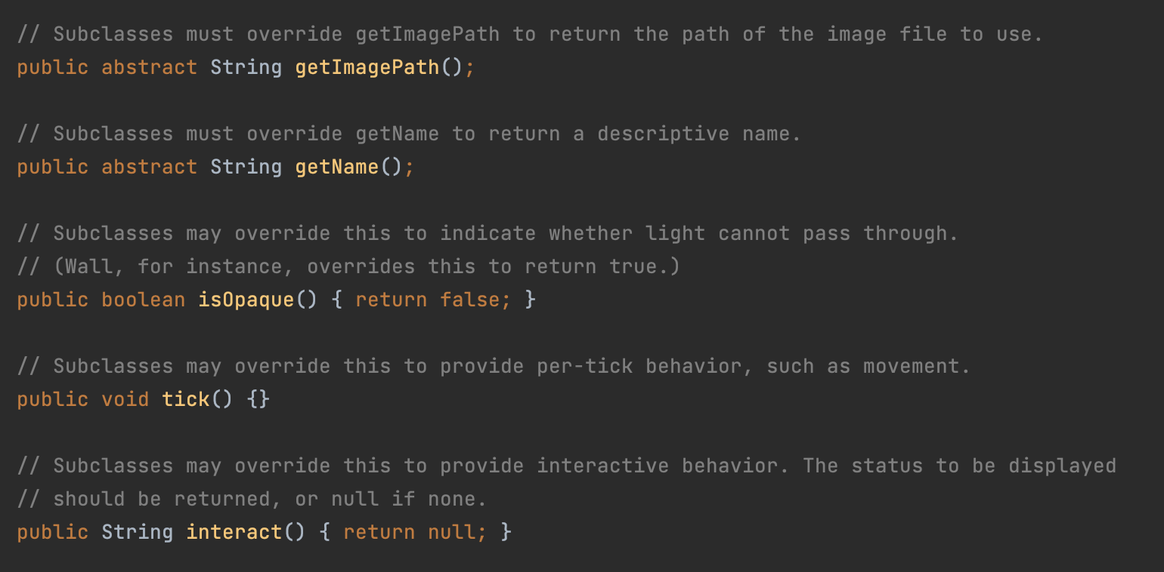
MazeObject, an abstract class with abstract methods

Slide 78
Interfaces
Languages like Python and C++ support multiple inheritance: Classes can inherit from multiple base classes.
Java has single inheritance. A class can only declare a single superclass.
However, Java has another feature called interfaces, which is similar to multiple inheritance.
A class extends only one superclass, but it implements zero or more interfaces.
Interfaces used to be on the AP Computer Science exam, but were removed in 2017. So, consider this bonus content.

Slide 79
Interfaces
/**
* The listener interface for receiving KeyEvents.
*/
public interface KeyListener extends EventListener {
/**
* KEY_PRESSED events are fired when any key (including a function
* key and cursor key) is pressed while the component has keyboard
* input focus.
* KeyEvent.getKeyCode() can be used to find out which key was pressed.
*/
void keyPressed(KeyEvent ke);
/**
* KEY_TYPED events are fired when a key representing a valid text
* character (not a function key or cursor key) is pressed.
* KeyEvent.getKeyChar() can be used to get the ASCII code of the key
* that was pressed.
*/
void keyTyped(KeyEvent ke);
/**
* KEY_RELEASED events are fired when a key is released.
*/
void keyReleased(KeyEvent ke);
}
Interfaces are like abstract classes, except ones where every method is abstract.*
An interface is a contract that a class has to implement completely.
If a class implements KeyListener, it must implement keyPressed, keyTyped and keyReleased, or it's a compile error.
*Mostly true. Default interface methods added in Java 8 (2014)

Slide 80
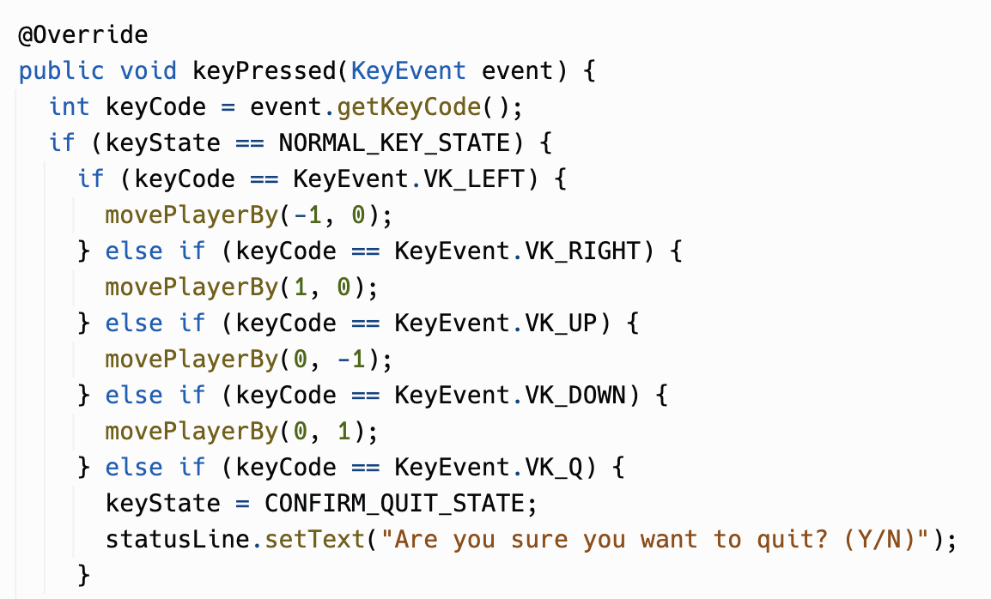
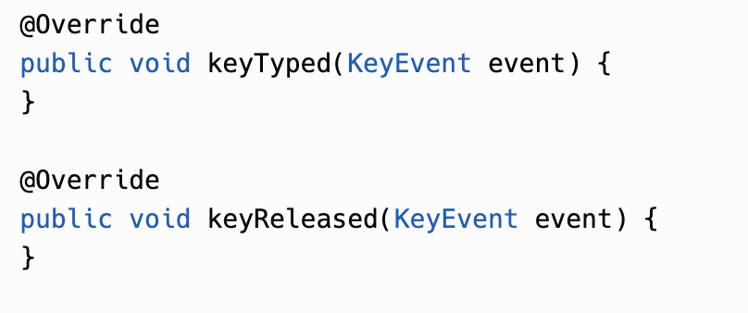
Game's KeyListener methods
Because Game implements KeyListener, it must implement keyPressed, keyTyped, and keyReleased methods. We only cared about keyPressed, but we had to supply something for the other two.
There is a fancy-pants way to avoid the empty methods, an abstract class called KeyAdapter + anonymous inner classes.
Java 8 (2014) did add "default interface methods" (which have bodies)

Slide 81
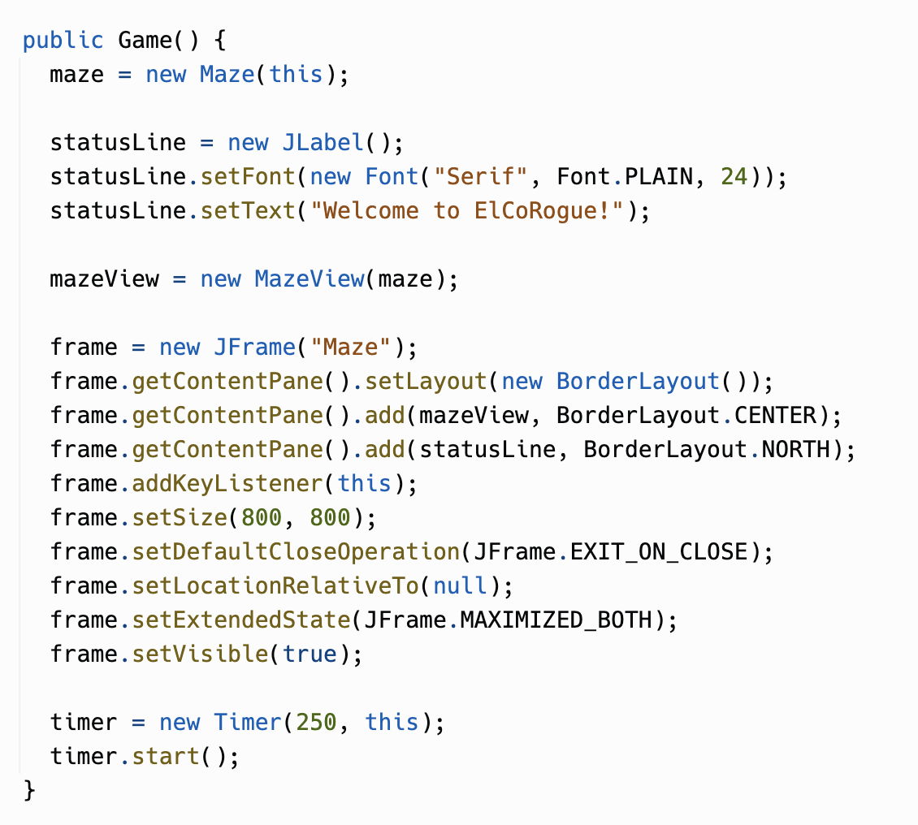
Game's call to addKeyListener
Game registers itself with Java Swing as a key listener by calling addKeyListener on the JFrame that is the game's main window.
The addKeyListener method takes a parameter of type KeyListener. Interfaces are types!
Because Game implements KeyListener, it can be cast to KeyListener.
// Legal. KeyListener k = (KeyListener)game;

Slide 82
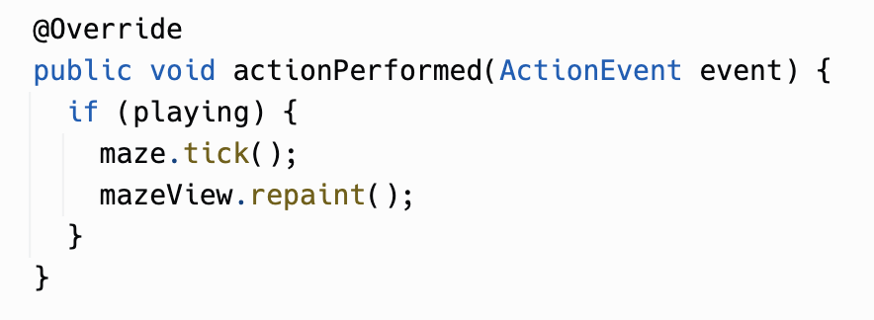
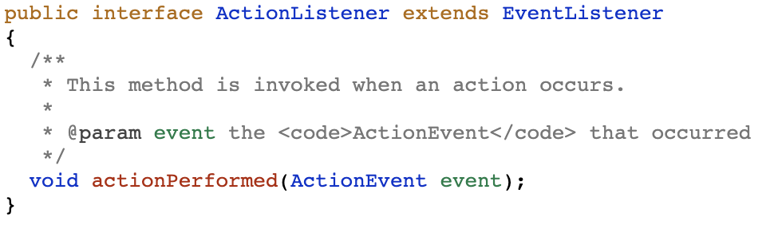
Game implements ActionListener

Slide 83
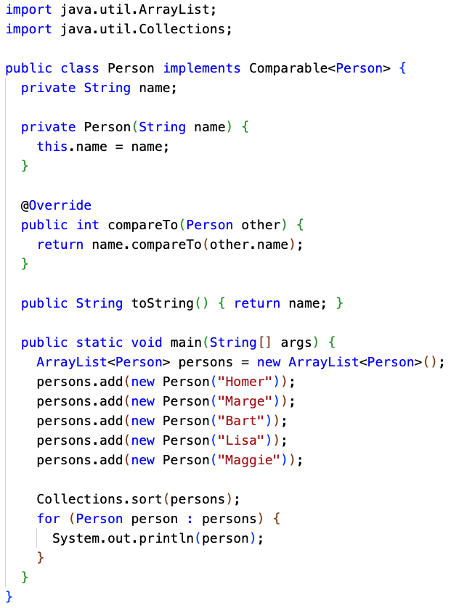
Comparable<T> interface
Another useful interface to implement is Comparable<T>
This has one method to implement, compareTo(), which should return an integer like String.compareTo()
If your class implements Comparable<T>, a list of your objects can be sorted with Collections.sort()

